Slide 1
物聯網實務 HW10
電機碩一 11278008 林佳慧
日期:2023/11/22

Slide 2
Exercise 10-1
Create a project

Slide 3
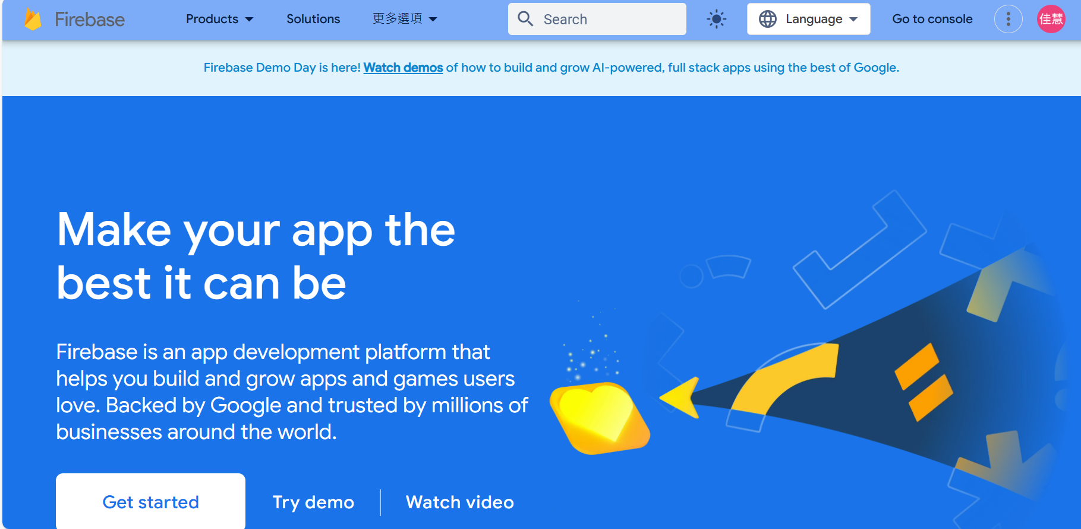
Firebase
https://firebase.google.com/

Slide 4
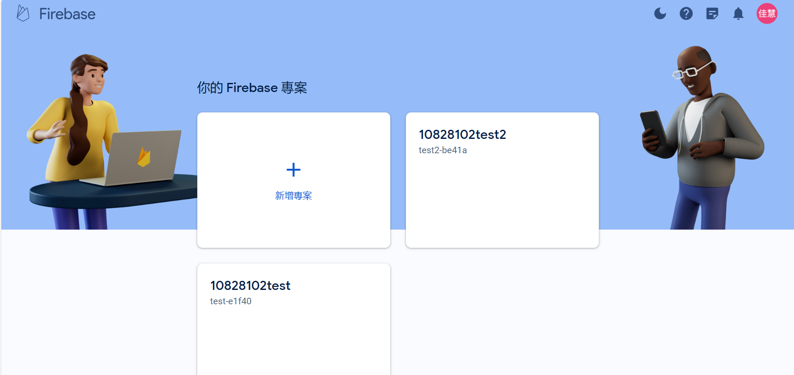
Create a project

Slide 5
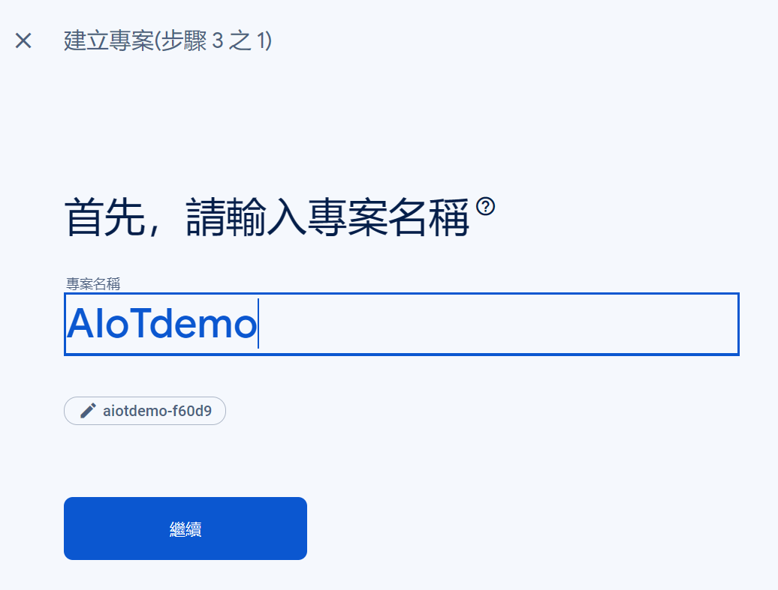

Slide 6
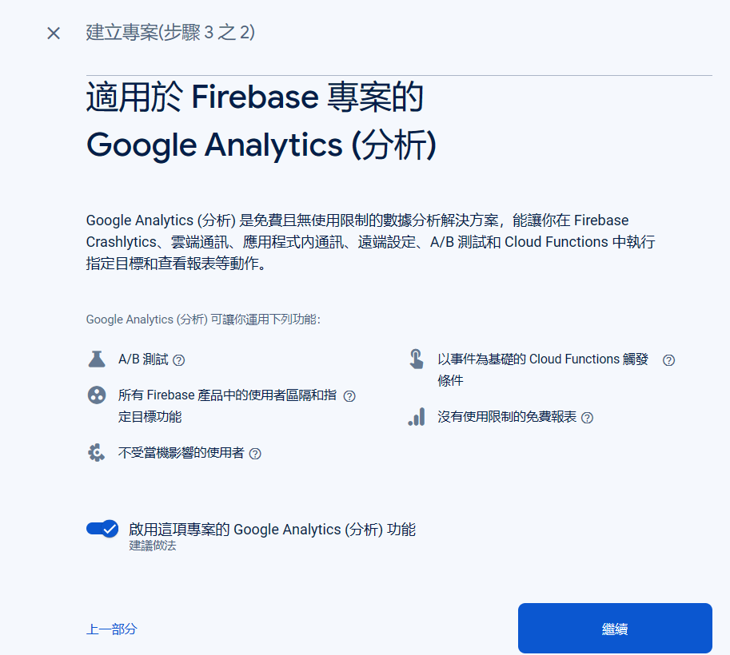
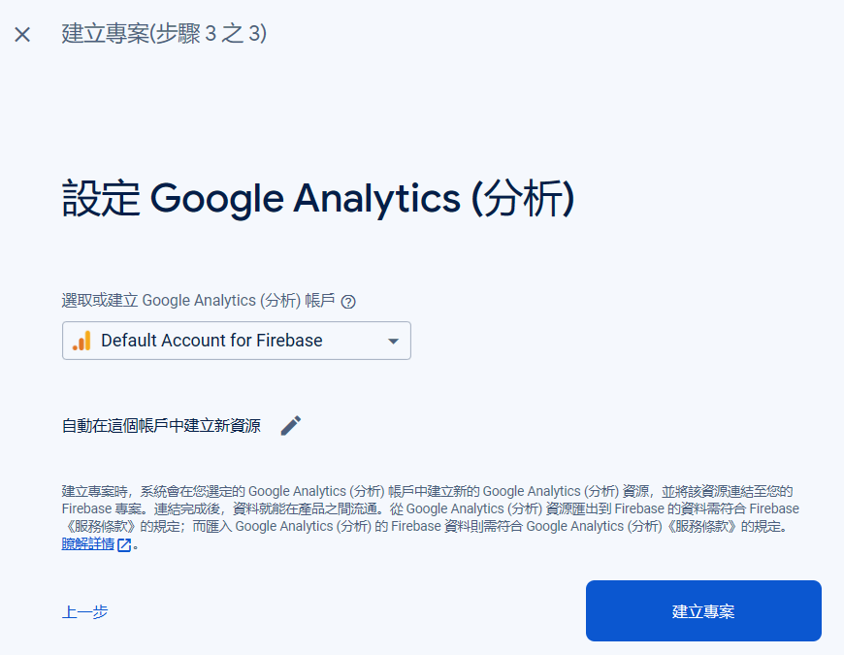
Analytics

Slide 7
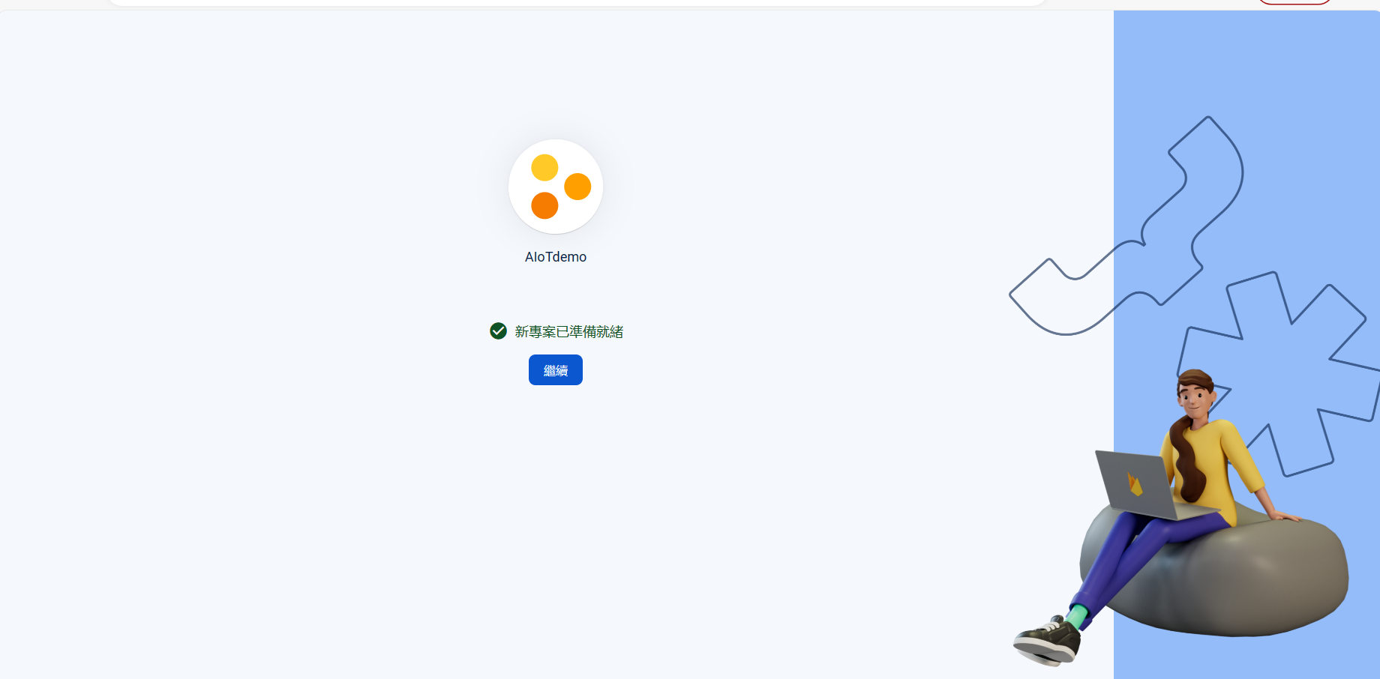
Your new project is ready

Slide 8
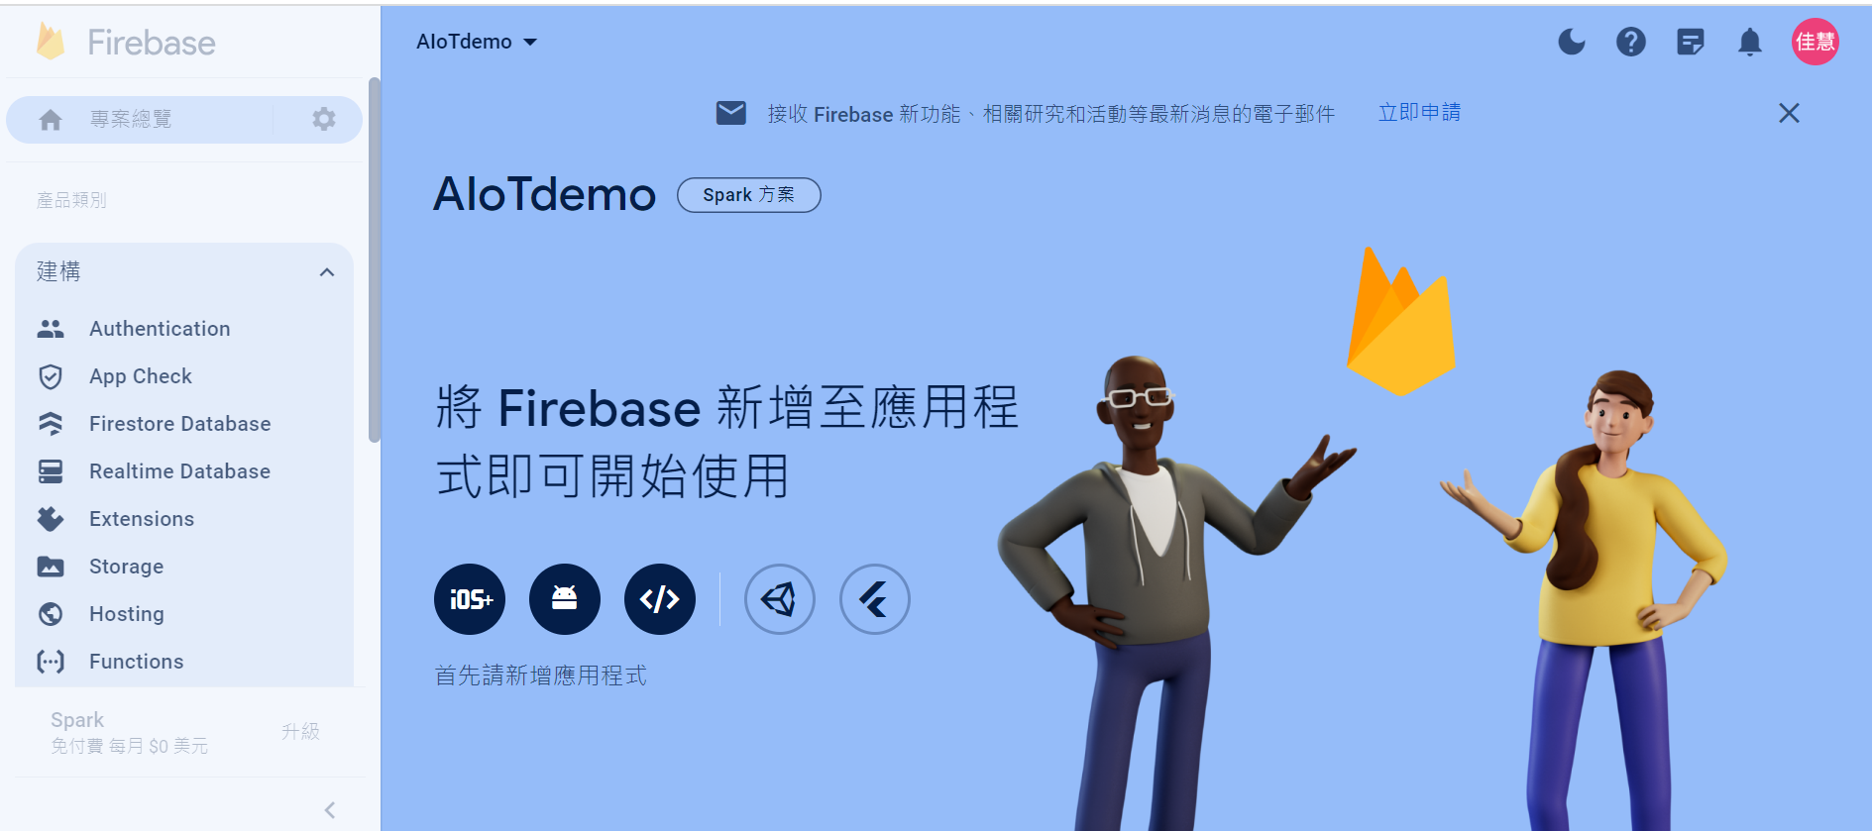
Project Desktop

Slide 9
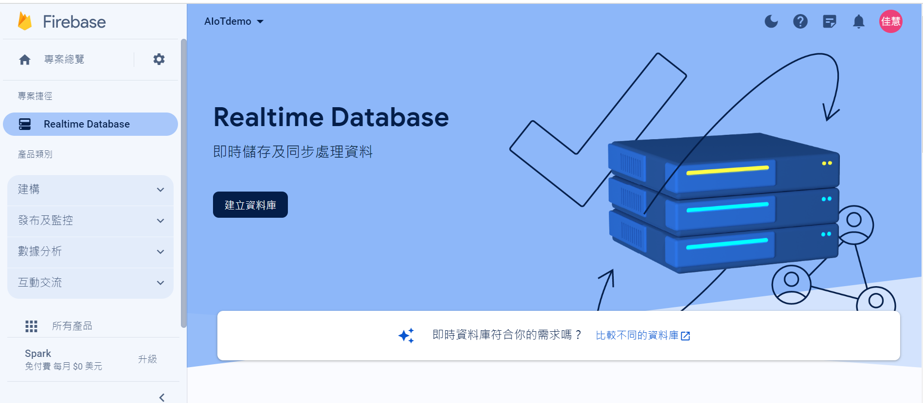
Create Database

Slide 10
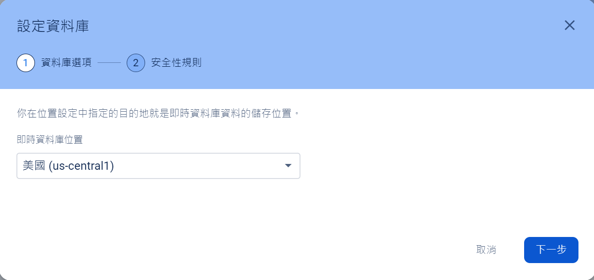
Set up database

Slide 11
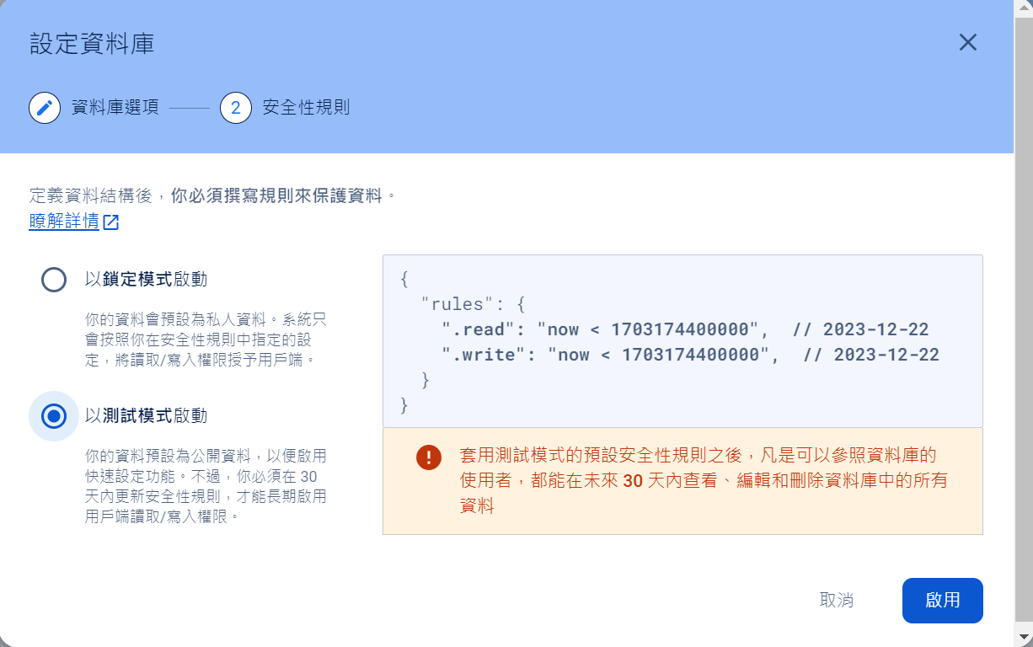
Start in test mode

Slide 12
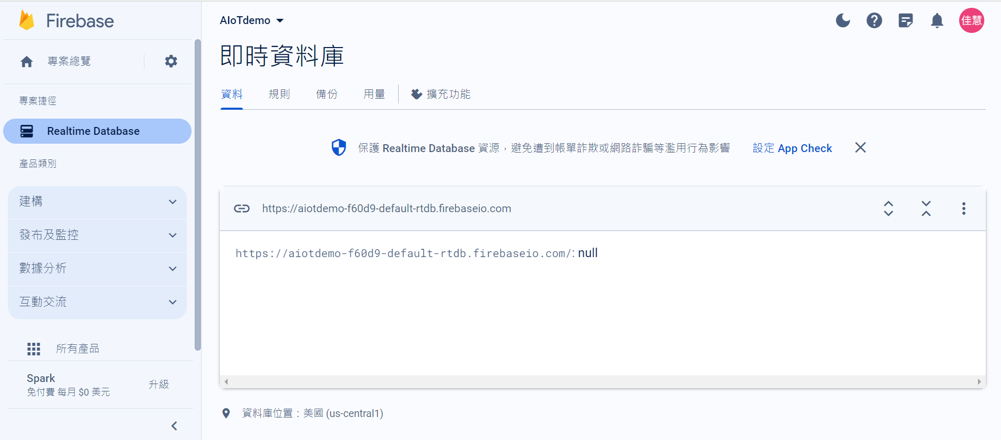

Slide 13
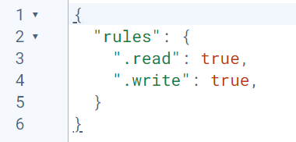
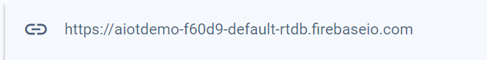

Slide 14
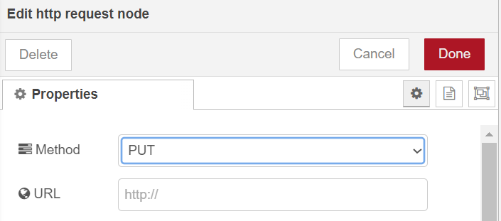
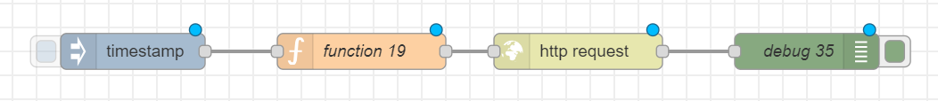
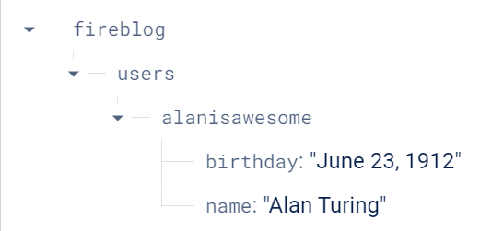
msg.url="https://aiotdemo-f60d9-default-rtdb.firebaseio.com/fireblog/users.json";
msg.payload={"alanisawesome": {"name": "Alan Turing", "birthday": "June 23, 1912"}};
return msg;

Slide 15
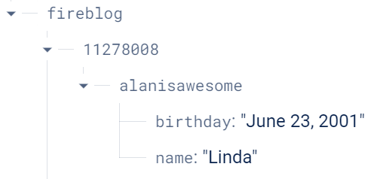
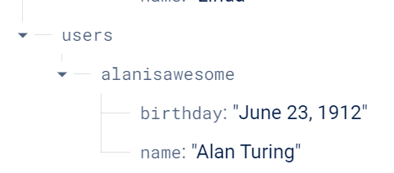
msg.url="https://aiotdemo-f60d9-default-rtdb.firebaseio.com/fireblog/11278008.json";
msg.payload={"alanisawesome": {"name": "Linda", "birthday": "June 23, 2001"}};
return msg;

Slide 16
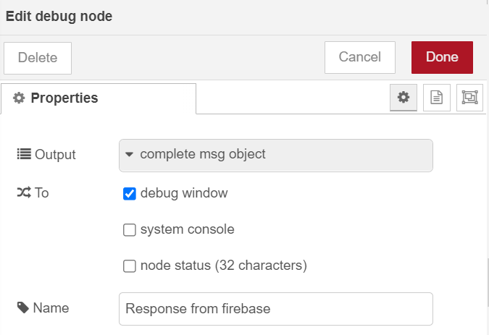
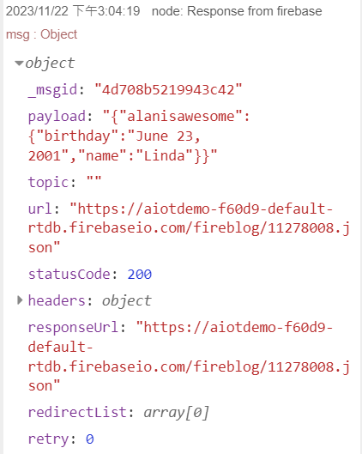

Slide 17
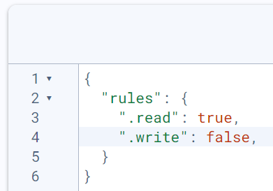

Slide 23
Exercise 10-2
Create a project

Slide 24
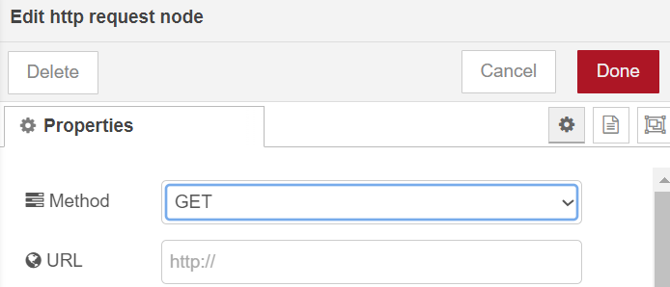
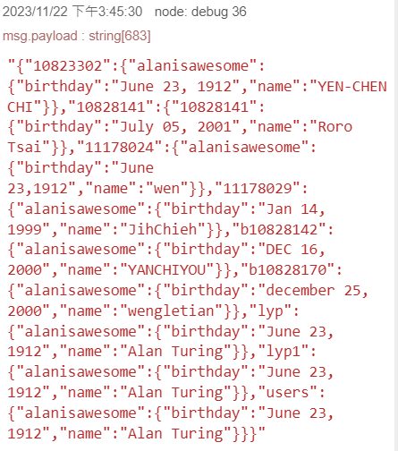
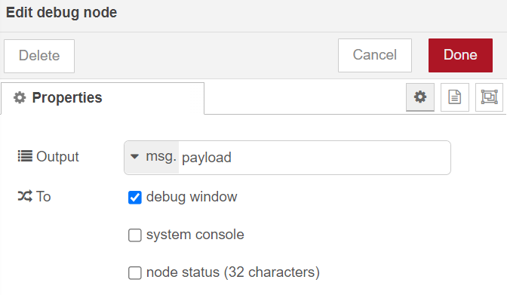
msg.url ="https://fornodered-312ce-default-rtdb.firebaseio.com/fireblog.json";
return msg;

Slide 25
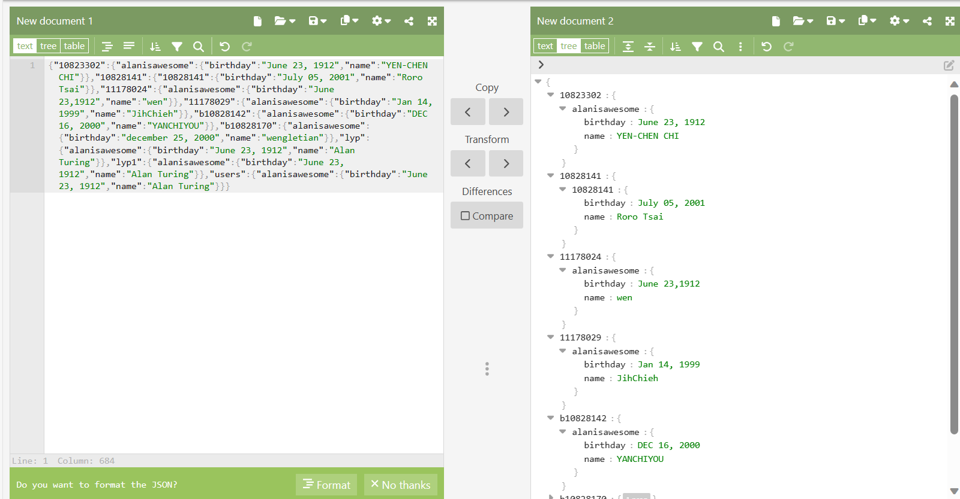

Slide 26
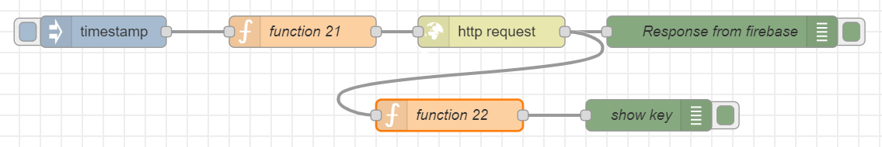
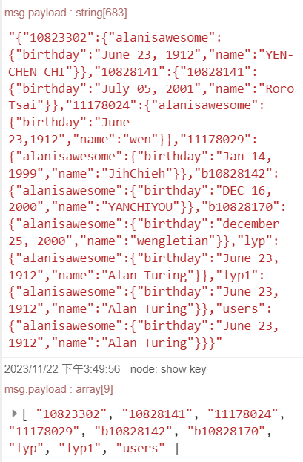
var result= msg.payload;
var obj=JSON.parse(result);
msg.payload=Object.keys(obj);
return msg;

Slide 29
Exercise 10-3
Create a project

Slide 30
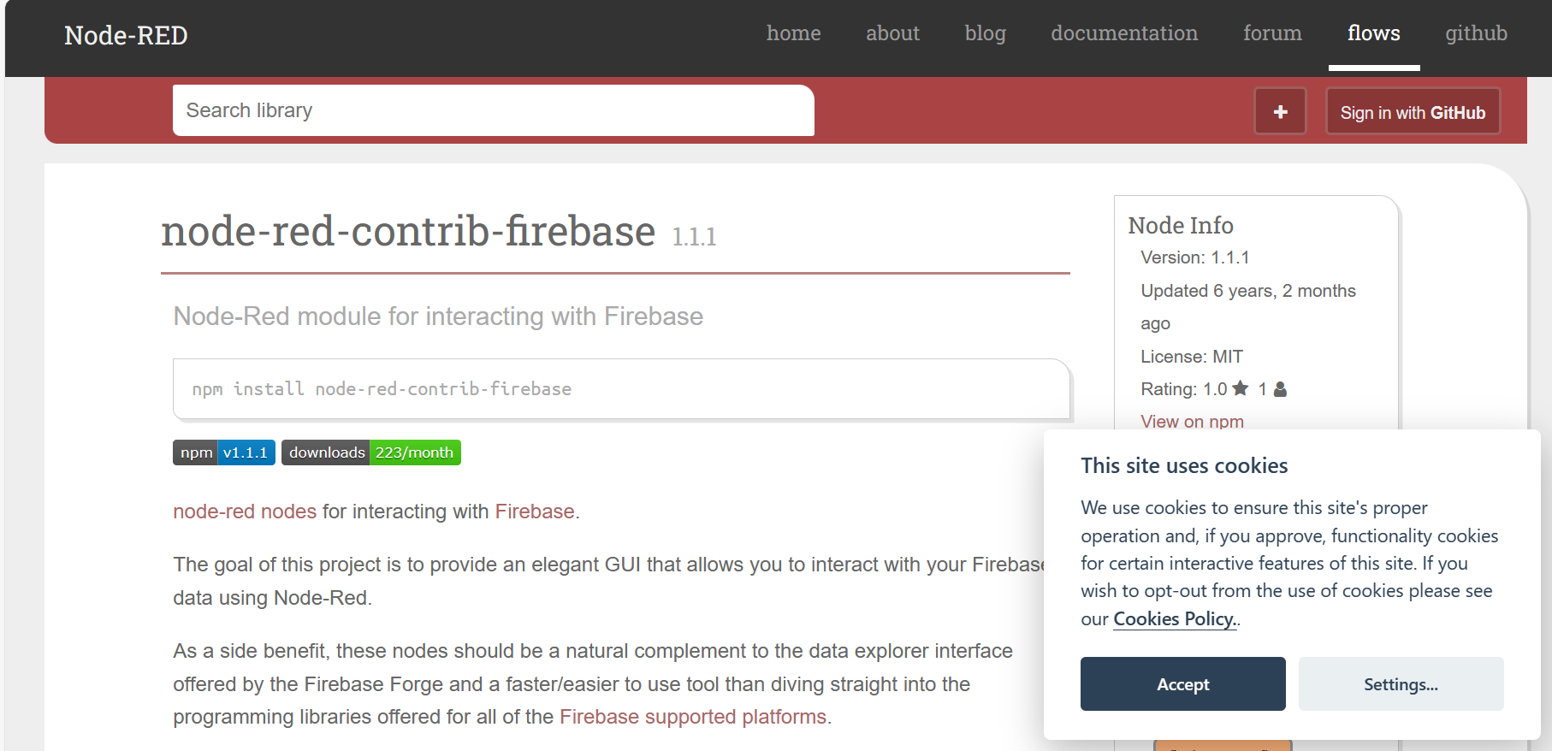

Slide 31
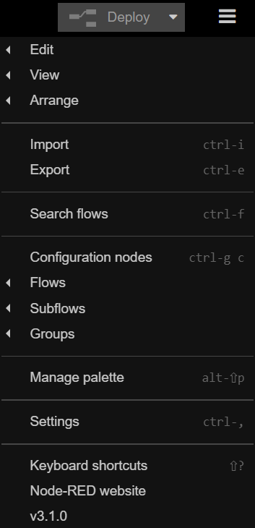
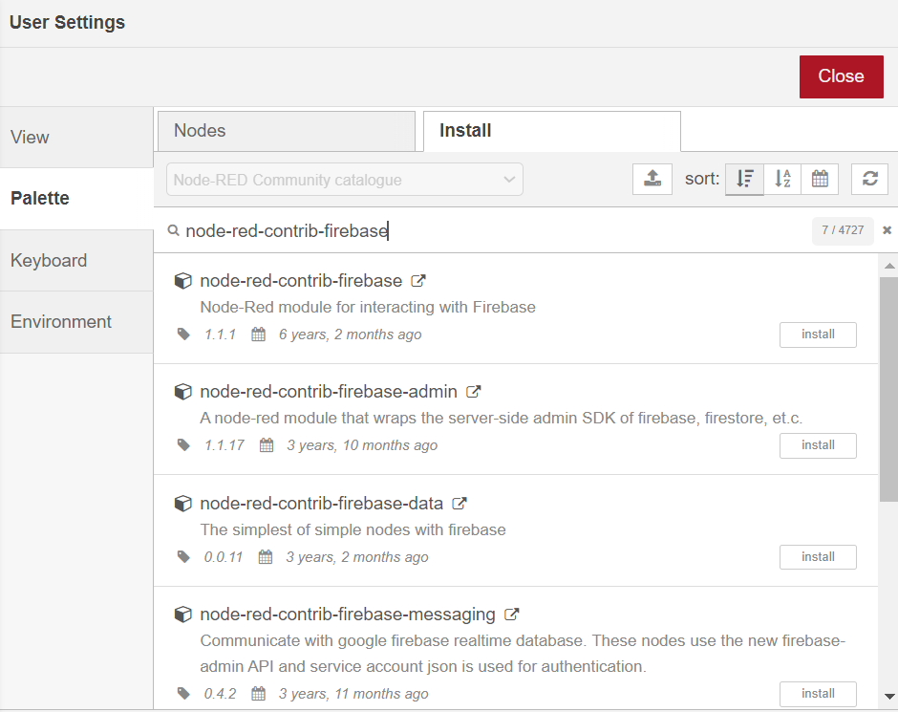
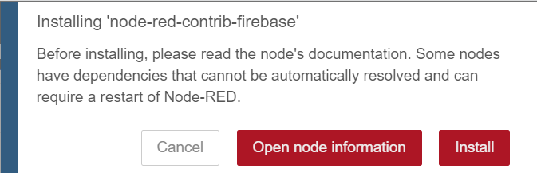

Slide 32
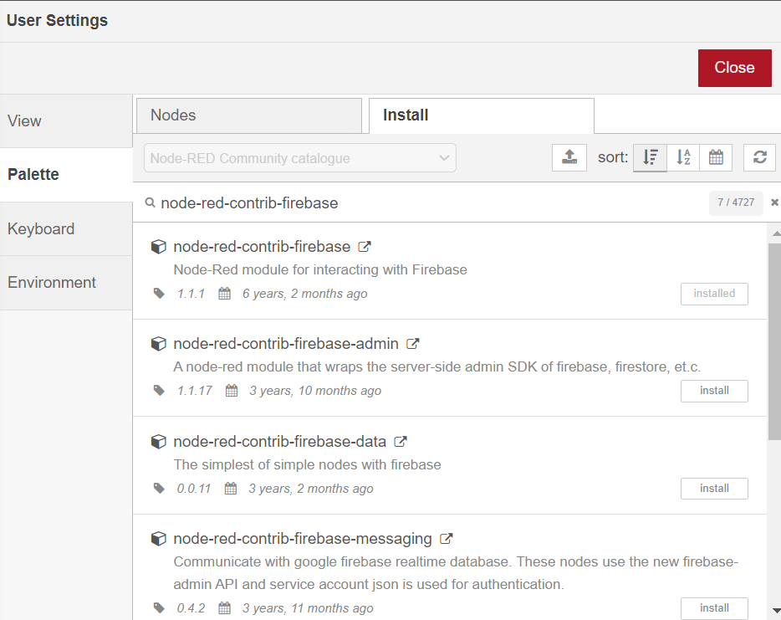
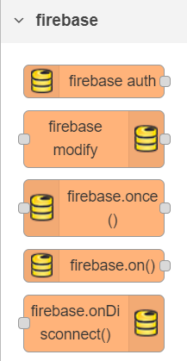

Slide 33
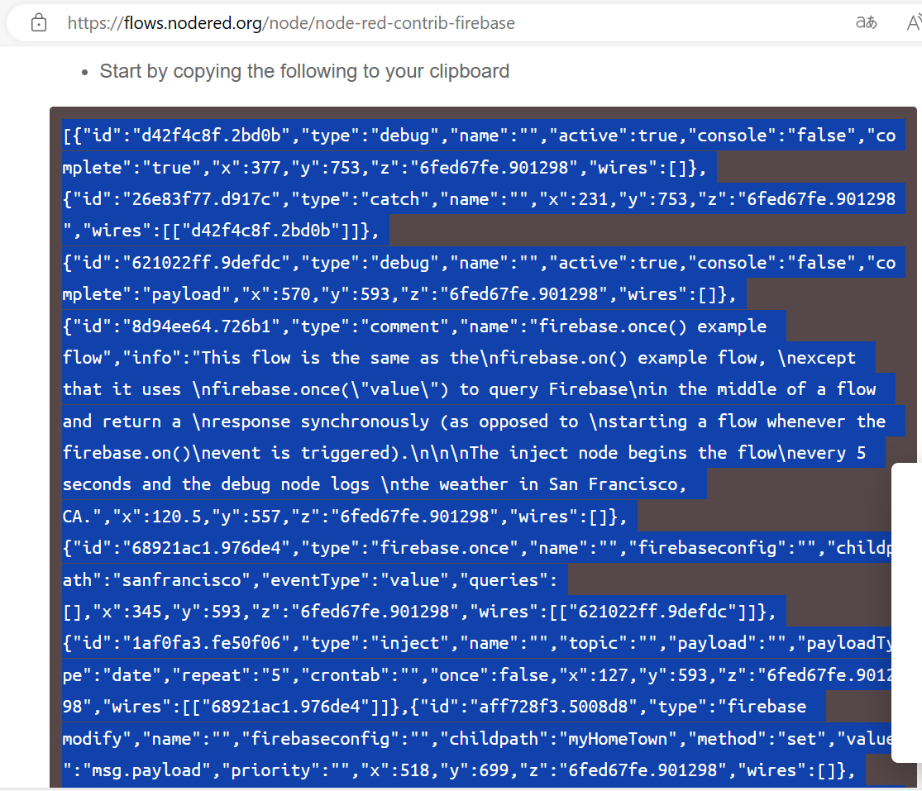
https://flows.nodered.org/node/node-red-contrib-firebase

Slide 34
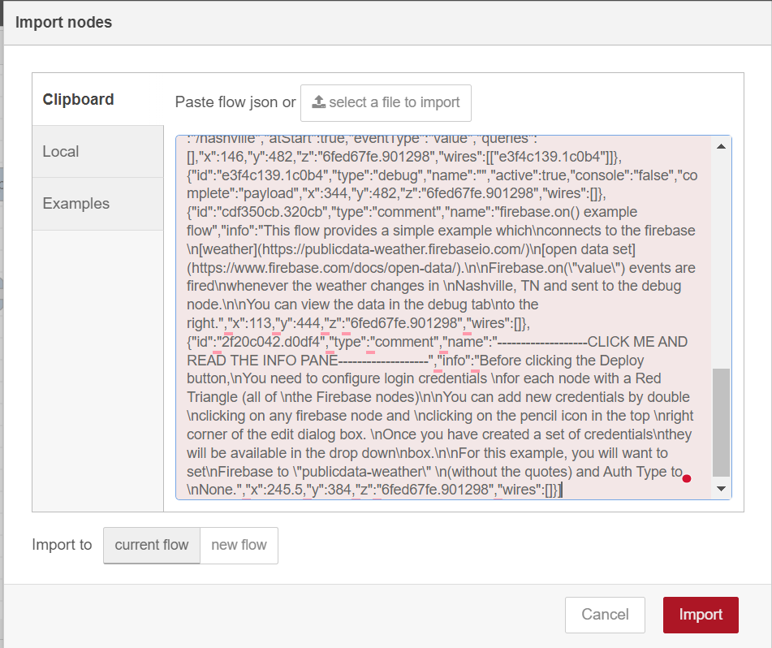
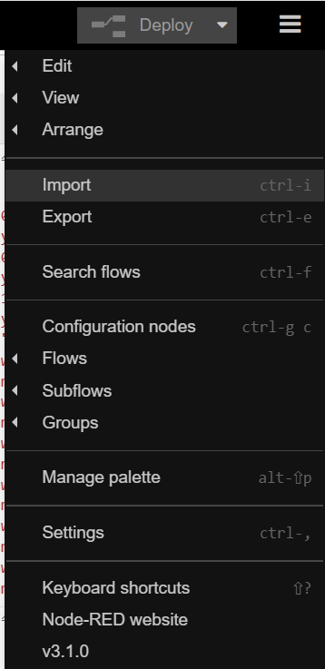

Slide 35
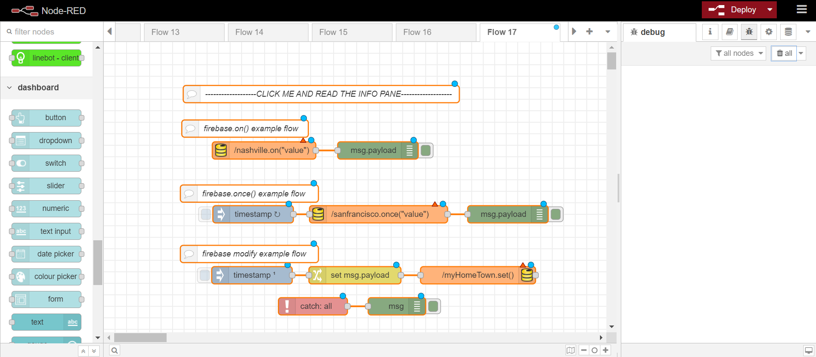

Slide 36
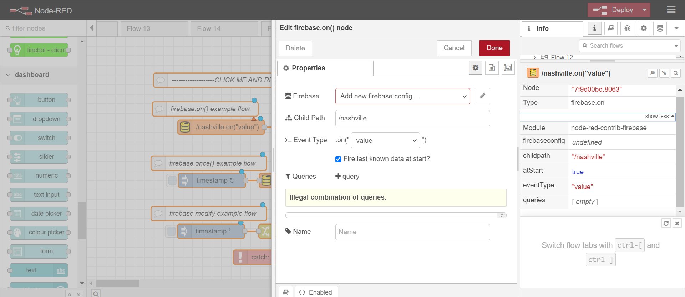

Slide 37
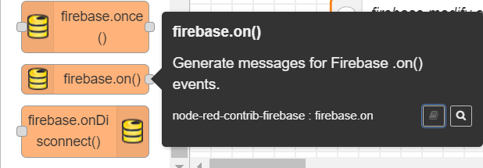
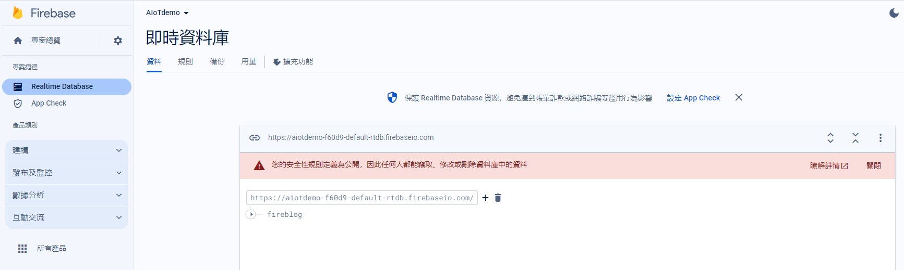
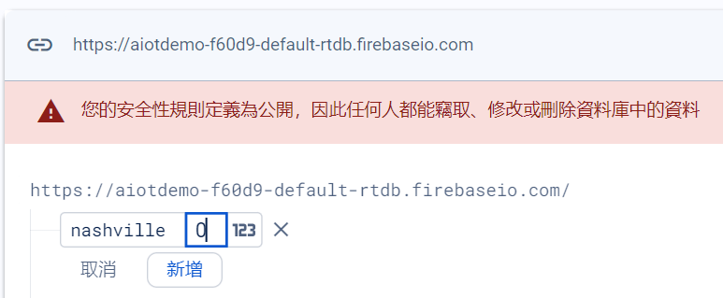

Slide 38
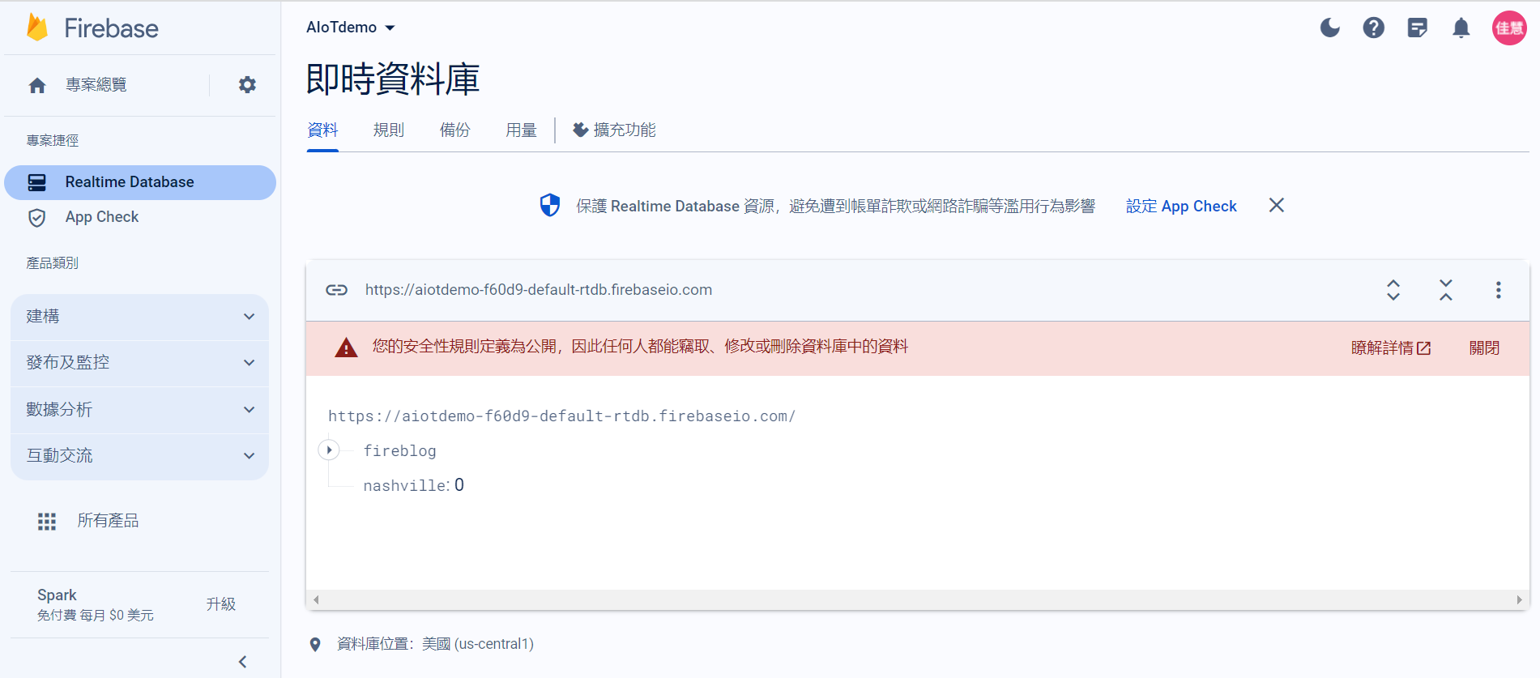

Slide 39
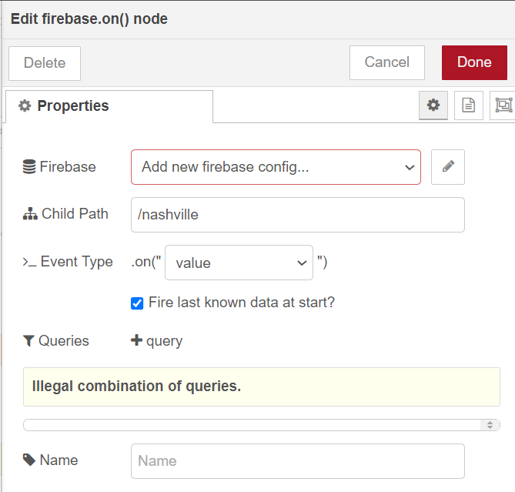
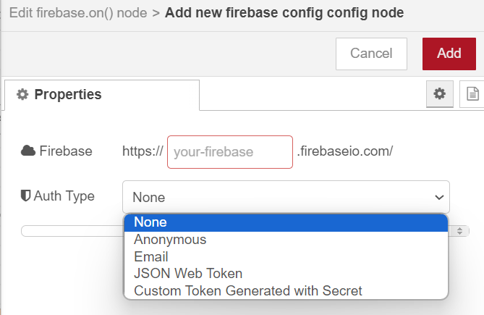
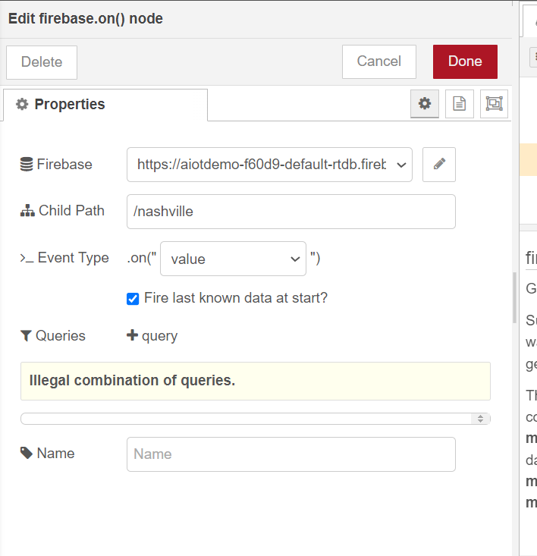
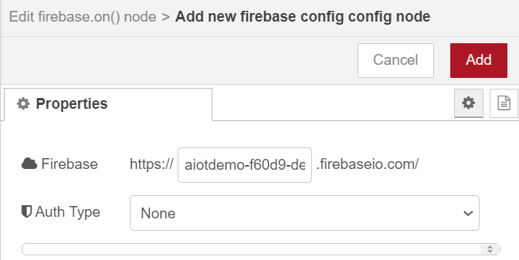

Slide 40
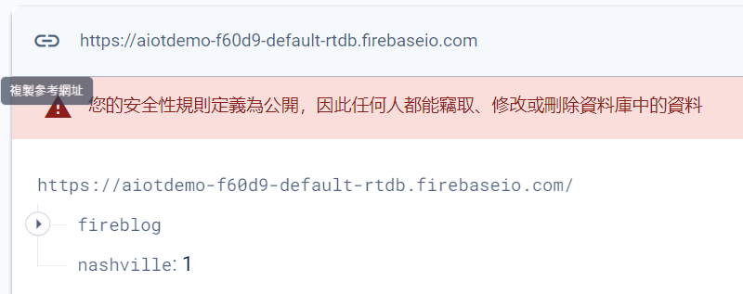
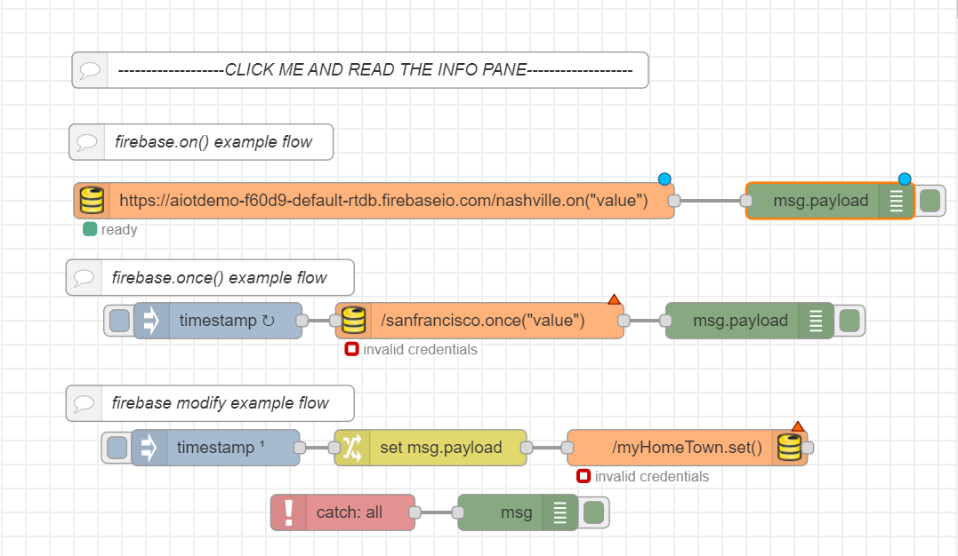
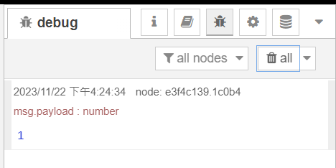

Slide 41
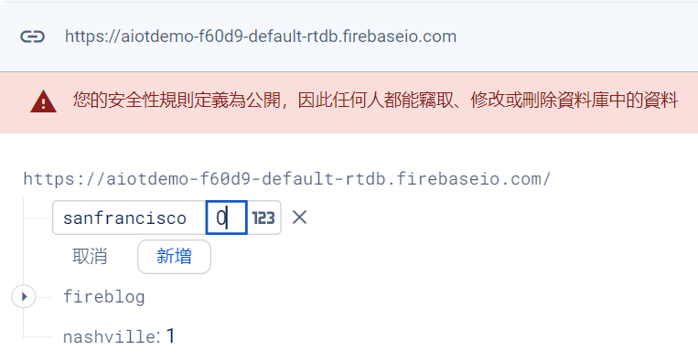



Slide 42


Slide 43



Slide 44


Slide 45



Slide 46



Slide 47



Slide 51
Exercise 10-4
Create a project

Slide 58
Homework 10-1
Design ten cities weather station
London • Singapur • Shanghai • Taipei • Taichung • Taoyuan • New York • ?? • ?? • ?

Slide 59



msg.url="https://aiotdemo-f60d9-default-rtdb.firebaseio.com/fireblog/users.json";
// msg.method = "PATCH";
msg.payload={"alanisawesome": {"name": "Jackson", "birthday": "August 23, 2001"}};
return msg;

Slide 64
Homework 10-2
Design ten cities weather station
London • Singapur • Shanghai • Taipei • Taichung • Taoyuan • New York • ?? • ?? • ?

Slide 65



var result= msg.payload;
var obj=JSON.parse(result);
msg.payload=Object.values(obj);
return msg;

